Slide 1
CoSSC - Comparative Study of Stellar Classification using DR-16 and DR-17 Datasets
By Vishal R, Sarvesh E and Sanjeevaditya T.M
Department of Computer Science and Engineering, College of Engineering, Guindy, Anna University,
Chennai, India
1

Slide 2
Introduction
Realizing the need of the hour about bringing in an efficient method of cataloguing, our team has produced an updated version of classifying stars, galaxies and quasars using precise accumulated inputs.
With an aim of aiding humanitarian advancement, the project’s foresight is to implement the program as a staple in research space stations.
The predetermined result assists in the process of selecting the appropriate algorithm, thus reducing the time consumption of a complex process.
We also worked on providing a detailed analysis on the variation of results when trained in the recent (DR-17) dataset.

Slide 3
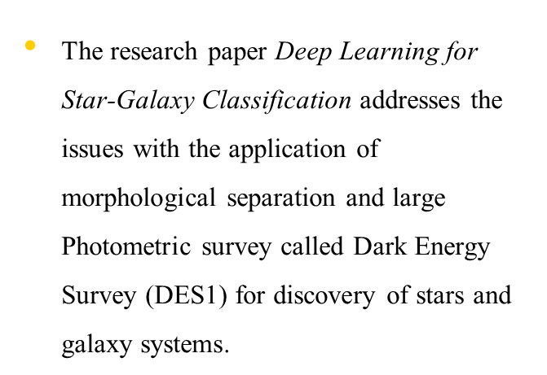
Literature Works
The paper Visual Discovery in Large-Scale Astrophysical Datasets; Experiences Using the Sloan Digital Sky Survey reports the experience of researchers in the field of developing visual discovery tools for the Sloan Digital Sky Survey

Slide 4
Literature Works
The researchers of the paper Classification of Stars using Stellar Spectra collected by the Sloan Digital Sky Survey adopt the procedure of applying redshift corrections to the spectra and reduce the number of flux measurements by feature selection.

Slide 5
Works referenced for utilising algorithms
Mahesh et al. (2005) used Random Forest Classifier for remote sensing classification to present results obtained and compare its performance with SVMs in terms of classification accuracy, training time and user-defined parameters.
Zerina et al. worked on Congestive Heart Failure detection using Random Forest Classifier. The paper discloses methods of implementing Machine learning algorithms to classify normal and congestive heart failure (CHF).

Slide 6
Works referenced for utilising algorithms
Prabrira et al address the growing issue of rice infestation prevalent in the Indian subcontinent through the paper they published which uses SVM to identify rice leaf disease. The paper consists of comparison between 13 CNN models and how deep features of resnet50 and SVM have proven to be the optimal algorithm.
Luigi et al investigate the various works available and provide suggestions regarding development. The research concludes with an efficiency report of LASSO [Least Absolute Shrinkage Selection Operator] penalization instead of the standard stepwise procedures in terms of methodological development.

Slide 7
Works referenced for utilising algorithms
Shaohua et al used Deep Multi-Layer perceptron classifier for Behavior analysis to estimate Parkinson’s Disease (PD) severity using smartphones. The aim of this paper is to identify the severity in PD patients’ actions by analyzing their speech and movement patterns, as measured with a smartphone accelerometer in their pocket at different times of the day.
Shubham et al [13] worked on Chronic Kidney Disease (CKD) diagnosis using a Multi-layer perceptron classifier. They proposed a Multi-Layer Perceptron Classifier to predict whether a patient suffers from CKD or not.

Slide 8
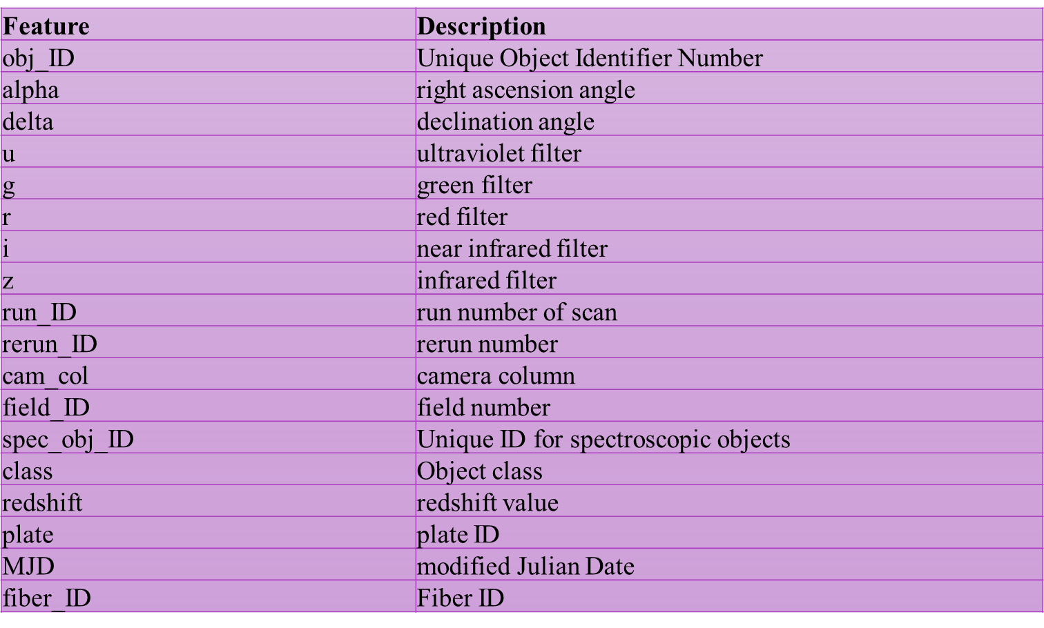
Dataset description of DR-16 and DR-17 dataset

Slide 9
Numerical summary of columns in DR-17 dataset
1

Slide 11
Numerical summary of columns in DR-16 dataset
2

Slide 13
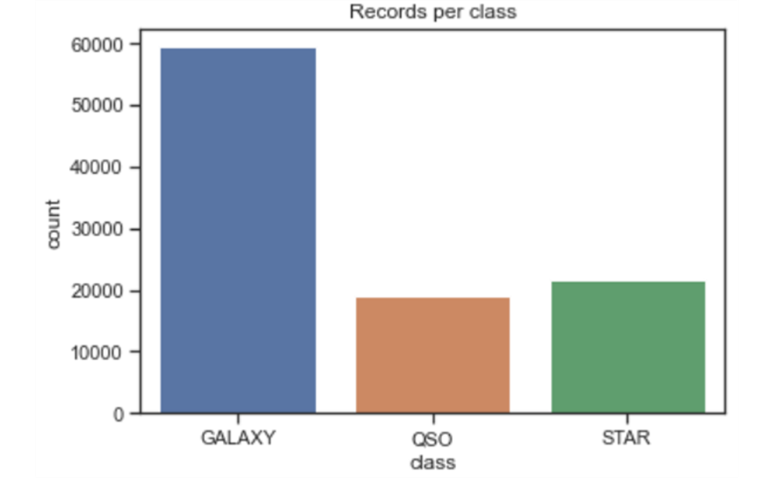
Frequency of data points in each class (GALAXY – galaxies, QSO – Quasars, STAR- stars)

Slide 14
Machine Learning Algorithms for Stellar Classification

Slide 15
Machine Learning Algorithms for Stellar Classification
Random Forest Classifier
Multi-Layer Perceptron
Decision Tree Classifier
Logistic Regression
Support Vector Machine
Your audience will listen to you or read the content, but won’t do both.

Slide 16
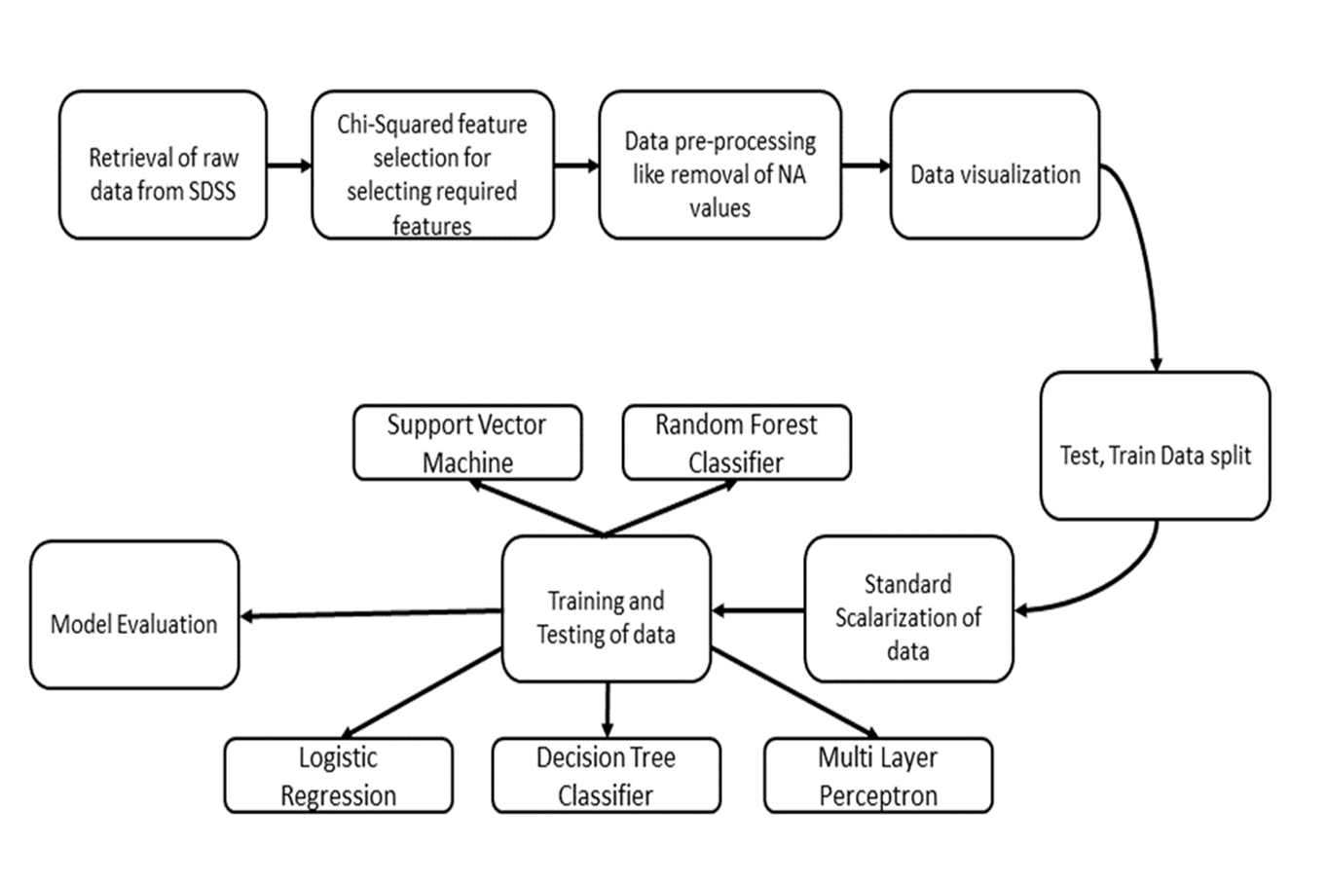
Proposed Workflow of the project

Slide 17
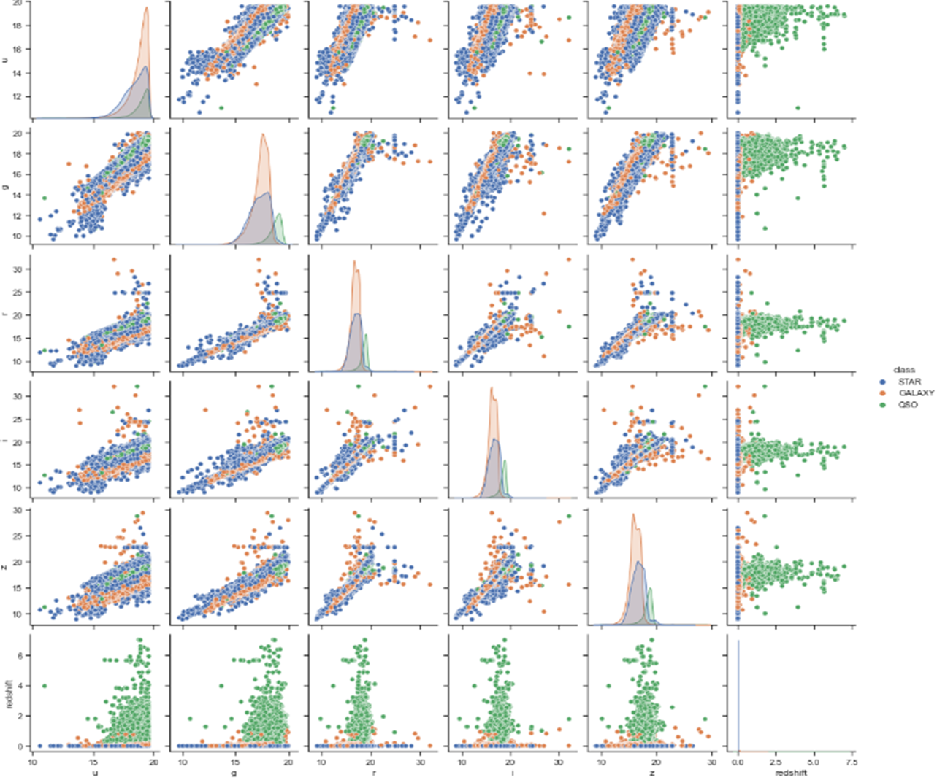
Pair plots between the pair of columns chosen for training the model

Slide 18
Proposed Workflow
The data is cleaned through various steps, which is then succeeded by Feature Engineering.
Out of the available 18 columns provided in the actual dataset provided by Sloan Digital Sky Survey’s DR17 , the columns ‘u’, ‘g’, ‘r’, ‘i’, ‘z’ and ‘redshift’ are used as input columns and ‘class’ as output column for the model to be trained.
Chi-Squared and Fisher filter feature selection algorithms are explored to find the essential features for the model.
The data is then visualized to look in for correlation between attributes in the dataset.

Slide 19
Proposed Workflow
After data visualization, to proceed forward, splitting of dataset into training and testing parts in the ratio of 3:1 is done and then scaling of the data to normal range of 0-1 for better efficiency of the model is found.
Finally, the trained dataset is fed into the model with an aim of making it adapt and learn the patterns present in the data. This in turn aids in the prediction of the result and compares the existing values to find its accuracy.

Slide 20
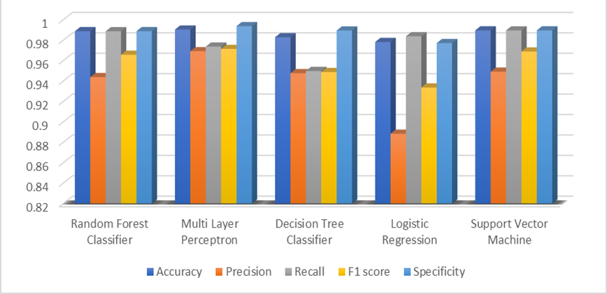
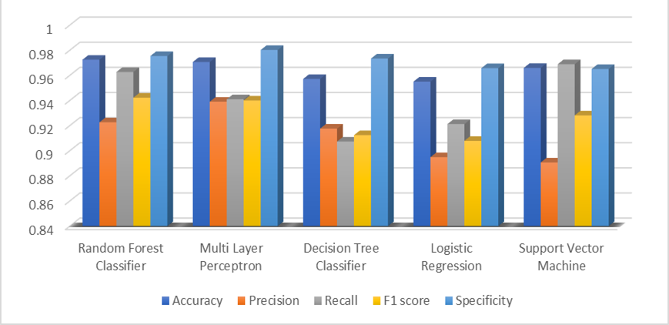
Accuracy metrics of models trained in DR-16 dataset
Accuracy metrics of models trained in DR-17 dataset

Slide 21
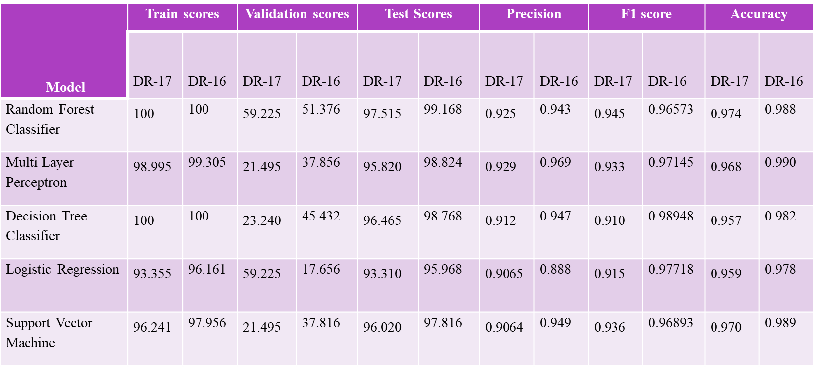
Comparison of model scoring metrics value for each of the model trained in DR-16 and DR-17 dataset

Slide 22
Results
3
22

Slide 23
Results and Conclusions
With the accuracies of all five models in hand, the comparative study has provided an insight that Random Forest Classifier fits well in the given dataset with an accuracy of 0.9742 and is followed by Decision Tree Classifier with an accuracy of 96.465.
But all 5 algorithms have an accuracy of more than 95%. Also, the test scores of all the algorithms are greater than 90% showing that all 5 models are performing better for DR-17 dataset.

Slide 24
Results and Conclusions
The accuracy metrics are seen to be lower for all models when trained in DR-17 when compared to those trained in DR-16.
The precision value for the ‘Quasar’ class in the Quasar-Non quasar prediction went from 0.99 for the DR-16 dataset to 0.94 for the DR-17 dataset.
This has an adverse effect on the accuracy value of the model fit in the DR-17 dataset. The drop in Quasar-Non quasar prediction can be explained by the large spread of Quasar data.

Slide 25
References
1. Zendehboudi, A., Baseer, M. A., &Saidur, R. (2018). Application of support vector machine models for forecasting solar and wind energy resources: A review. Journal of cleaner production, 199, 272-285.
2. Sethy, P. K., Barpanda, N. K., Rath, A. K., & Behera, S. K. (2020). Deep feature-based rice leaf disease identification using support vector machine. Computers and Electronics in Agriculture, 175, 105527.
3. Singh, V., Poonia, R. C., Kumar, S., Dass, P., Agarwal, P., Bhatnagar, V., & Raja, L. (2020). Prediction of COVID-19 corona virus pandemic based on time series data using Support Vector Machine. Journal of Discrete Mathematical Sciences and Cryptography, 23(8), 1583-1597.
4. https://www.sdss.org/dr16/algorithms/qso_catalog/
5. https://pweb.cfa.harvard.edu/research/sloan-digital-sky-survey-sdss
6. Iyer, G. R. C., &Vastare, K. C. Deep Learning for Star-Galaxy Classification.
7. Caniglia, G., Krokos, M., Becciani, U., Gheller, C., Nichol, R., Comparato, M., ... & Vitello, F. (2009, July). Visual discovery in large-scale astrophysical datasets; experiences using the sloan digital sky survey. In 2009 Second International Conference in Visualisation (pp. 10-15). IEEE.

Slide 26
References
8. Bai, Y., Liu, J., Wang, S., & Yang, F. (2018). Machine Learning Applied to Star–Galaxy–QSO Classification and Stellar Effective Temperature Regression. The Astronomical Journal, 157(1), 9.
9. Brice, M., &Andonie, R. (2019, July). Classification of stars using stellar spectra collected by the Sloan Digital Sky Survey. In 2019 International Joint Conference on Neural Networks (IJCNN) (pp. 1-8). IEEE.
10. Pedregosa, F., Varoquaux, G., Gramfort, A., Michel, V., Thirion, B., Grisel, O., &Duchesnay, E. (2011). Scikit-learn: Machine learning in Python. the Journal of machine Learning research, 12, 2825-2830.
11. Turner, C. R., Fuggetta, A., Lavazza, L., & Wolf, A. L. (1999). A conceptual basis for feature engineering. Journal of Systems and Software, 49(1), 3-15.
12. Li, J., Cheng, K., Wang, S., Morstatter, F., Trevino, R. P., Tang, J., & Liu, H. (2017). Feature selection: A data perspective. ACM computing surveys (CSUR), 50(6), 1-45.
13. Bai, Y., Chen, M., Zhou, P., Zhao, T., Lee, J., Kakade, S., ... &Xiong, C. (2021, July). How Important is the Train-Validation Split in Meta-Learning?. In International Conference on Machine Learning (pp. 543-553). PMLR.
14. , S., Karreth, J., Beger, A., & Williams, R. (2019). BayesPostEst: An r package to generate postestimation quantities for Bayesian MCMC estimation. Journal of Open Source Software, 4(42), 1722.

